Slide 1
Osher Lifelong Learning Institute, Spring 2025
Contemporary Economic Policy
University of Hawaii, Manoa
Host: Geoffrey Woglom
Director, National Economic Education Delegation

Slide 2
National Economic Education Delegation
Vision
  One day, the public discussion of policy issues will be grounded in an accurate perception of the underlying economic principles and data.
Mission
  NEED unites the skills and knowledge of a vast network of professional economists to promote understanding of the economics of policy issues in the United States.
NEED Presentations
  Are nonpartisan and intended to reflect the consensus of the economics profession.

Slide 3
Who Are We?
Honorary Board: 54 members
  2 Fed Chairs: Janet Yellen, Ben Bernanke
  6 Chairs Council of Economic Advisers
    Furman (D), Rosen (R), Bernanke (R), Yellen (D), Tyson (D), Goolsbee (D)
  3 Nobel Prize Winners
    Akerlof, Smith, Maskin
Delegates: 652+ members
  At all levels of academia and some in government service
  All have a Ph.D. in economics
  Crowdsource slide decks
  Give presentations
Global Partners: 48 Ph.D. Economists
  Aid in slide deck development

Slide 4
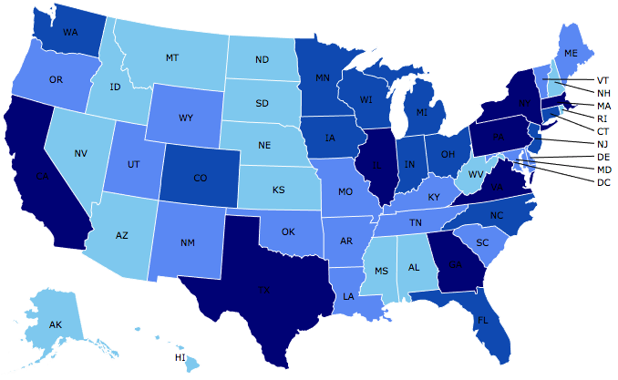
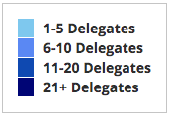
Where Are We?

Slide 5
Available NEED Topics Include:
US Economy
Healthcare Economics
Climate Change
Economic Inequality
Economic Mobility
Trade and Globalization
Minimum Wages
Immigration Economics
Housing Policy
Federal Budgets
Federal Debt
Black-White Wealth Gap
Autonomous Vehicles
US Social Policy

Slide 6
Course Outline
Contemporary Economic Policy
  Week 1 (6/2): Economic Update (Geoffrey Woglom, Amherst College)
  Week 2 (6/09): Climate Change Economics (Sarah Jacobson, Williams College)
  Week 3 (6/16): Economic Mobility (Jon Haveman, Exec Director, NEED)
  Week 4 (6/23): Health Economics (Robert Rebelein, Vassar College)
  Week 5 (6/30): Cryptocurrencies (Joan Nix Queens College (CUNY)

Slide 7
How Economists Decide How Much to Fight
Climate Change: Cost Benefit Analysis
Abating greenhouse gas emissions is costly…
… but without action, climate change damages are even more costly.
Goal is not zero emissions, but efficient level that achieves a balance.
Expected costs of reducing emissions
Expected damages from allowing climate change

Slide 8
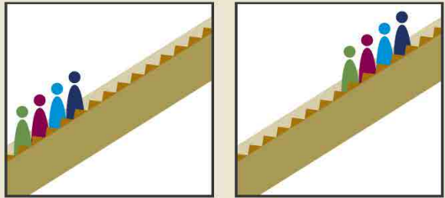

More on Absolute vs Relative Mobility
Can there be absolute mobility with NO relative mobility?
  Yes: if everybody experiences the same increase in income, there will be no relative mobility.
Can there be relative mobility with NO absolute mobility?
  Yes: There can be a dramatic reshuffling of the distribution even if there is no increase in average income.
Parents Kids
Parents Kids
+2
-1
+1
-2

Slide 9
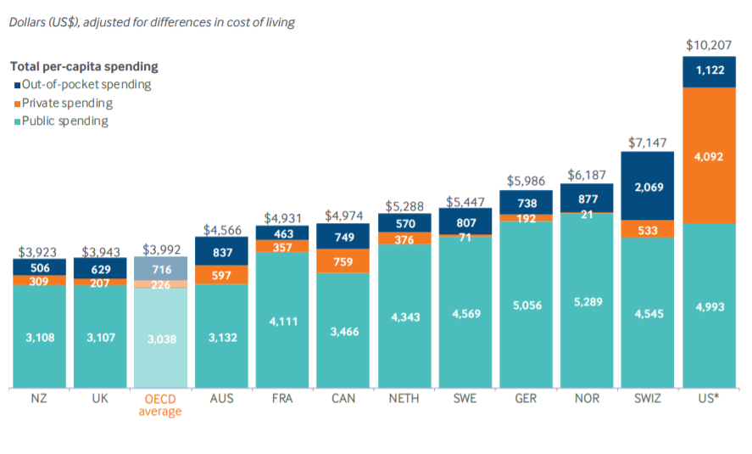
International Per Capita Healthcare Spending
US spends more than twice the OECD average
Source: Roosa Tikkanen and Melinda K. Abrams, U.S. Health Care from a Global Perspective, 2019: Higher Spending, Worse Outcomes (Commonwealth Fund, Jan. 2020).
Notes:
Some good resources:
https://www.commonwealthfund.org/publications/issue-briefs/2020/jan/us-health-care-global-perspective-2019
A bit older report: https://www.commonwealthfund.org/publications/issue-briefs/2015/oct/us-health-care-global-perspective
https://www.healthsystemtracker.org/chart-collection/quality-u-s-healthcare-system-compare-countries/#item-overall-age-specific-potential-years-of-life-lost-per-100000-population-1990-2017
https://axenehp.com/international-healthcare-systems-us-versus-world/

Slide 10
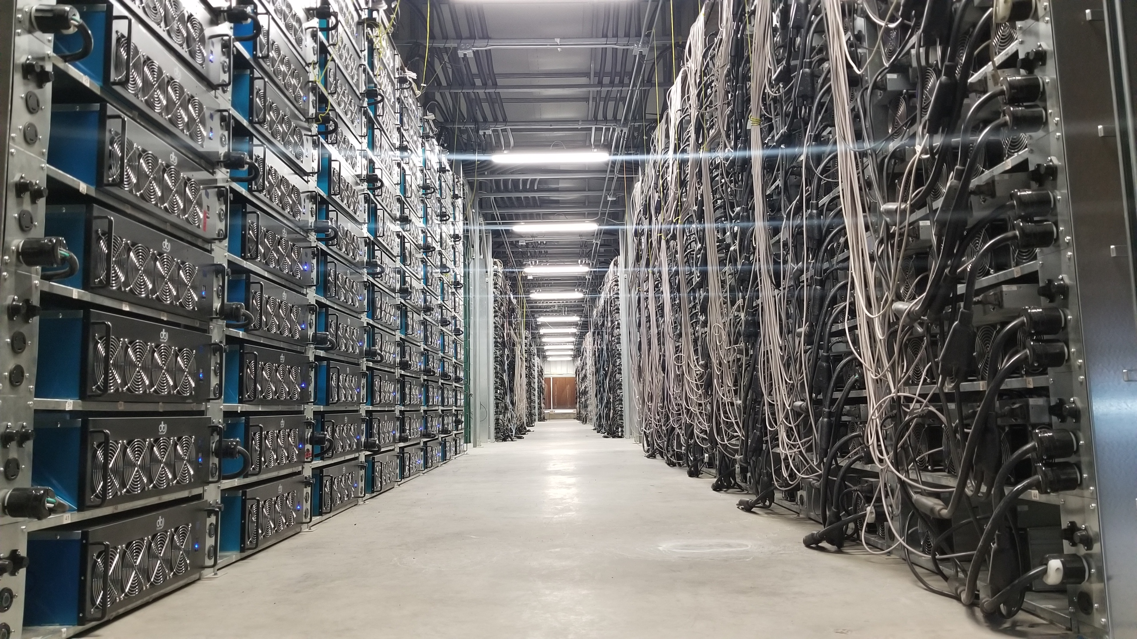
Bitcoin mine

Slide 11
Submitting Questions
Submit questions in the chat or raising your digital hand. I will try to address questions as they come up.
We will do a verbal Q&A once the material has been presented.
Slides will be available from the NEED website tonight https://needecon.org/delivered_presentations.php.
My macro site: https://sites.google.com/view/macro-current-issues/economic-update

Slide 12
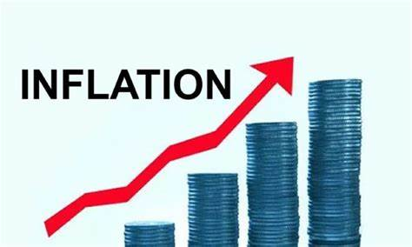

US Economy: Update
Geoffrey Woglom,
Professor of Economics
Amherst College, emeritus
June 2, 2025

Slide 13
Outline for the Talk
Quick Overview of State of the Economy
Where we are with:
  The “Big Beautiful Bill.”
  Tariffs

Slide 14
Gross Domestic Product: 2025Q1 = $30.0 tr
$31.2
Less Imports
-$4.5
Plus Exports
+$3.3
Equals GDP
$30.0

Slide 15
Basic GDP Accounting
Trade Deficit is when imports (IM) exceed exports (EX)
Trade Deficits arise when we spend domestically more than we produce
Y - C - I – G = -IM + EX, $30.0-$31.2=-$1.2
Useful definition Y – C – G is “National Saving” the sum of private saving less the government deficit. Rearranging
(Y – C - G )– I = National Saving less Investment = -IM + EX = Trade Deficit
We spend more than we produce when national saving isn’t sufficient to finance our investment, so we borrow from abroad.
Trade Deficit = Borrowing from foreigners = National Saving less Investment.
Key Takeaway: Trade Deficits are Associated with an imbalance of national saving and investment

Slide 16
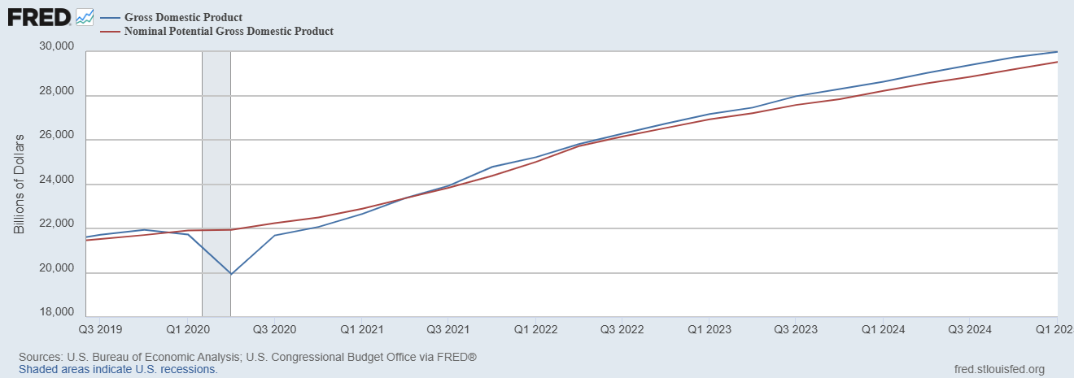
GDP and ‘Potential’ during the Recovery
Grey bar indicates recessions
Source: Fred, St Louis Fed

Slide 17
What is a Recession?
Defined by the National Bureau of Economic Research (NBER)
“The NBER's definition emphasizes that a recession involves a significant decline in economic activity that is spread across the economy and lasts more than a few months.”
Popular Rule of Thumb: Two or more, consecutive quarters where Real GDP falls. (Doesn’t always work!)
Recessions are caused by a drop in total spending (remember the consumer).

Slide 18
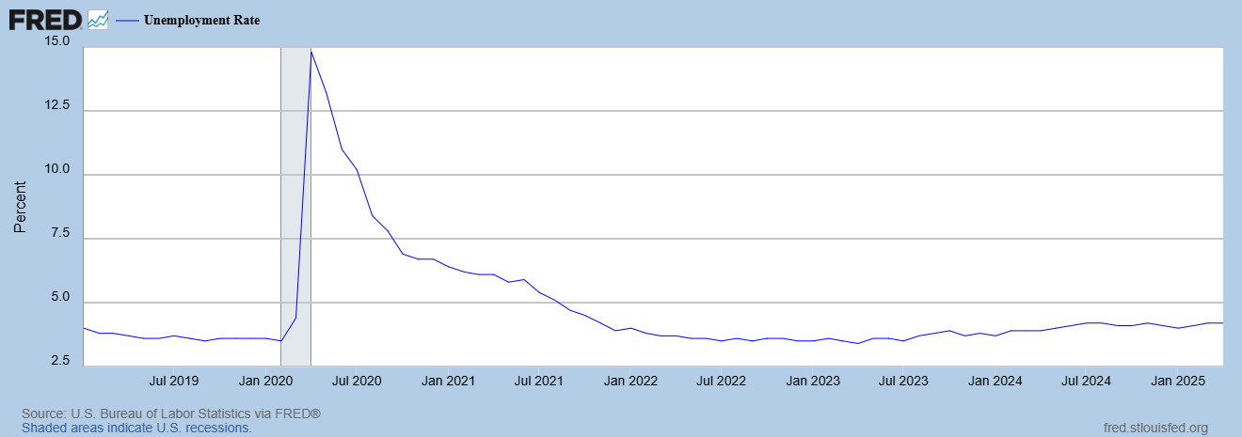
Unemployment is Near Record Lows

Slide 19
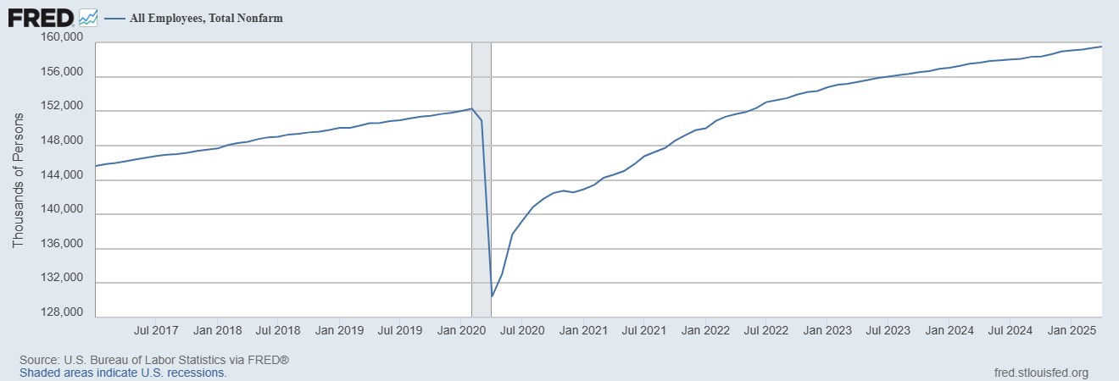
Where Have All the Workers Gone?
Source: Fred, St Louis Fed

Slide 20
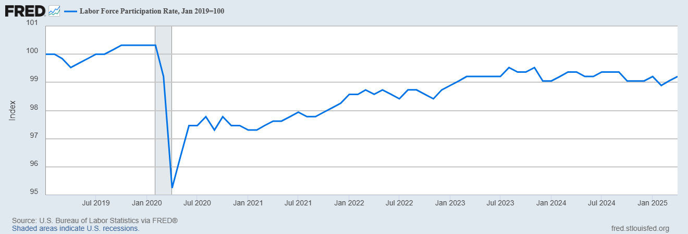
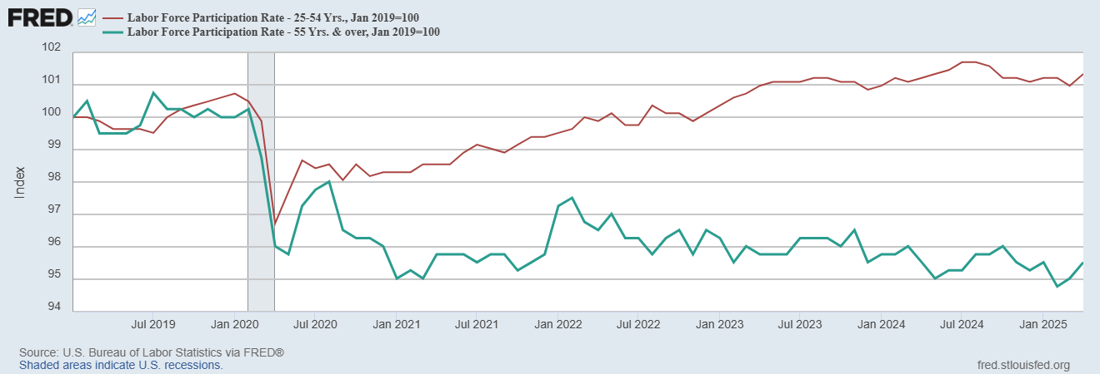
The Aging of the Labor Force
Notes:
F

Slide 21
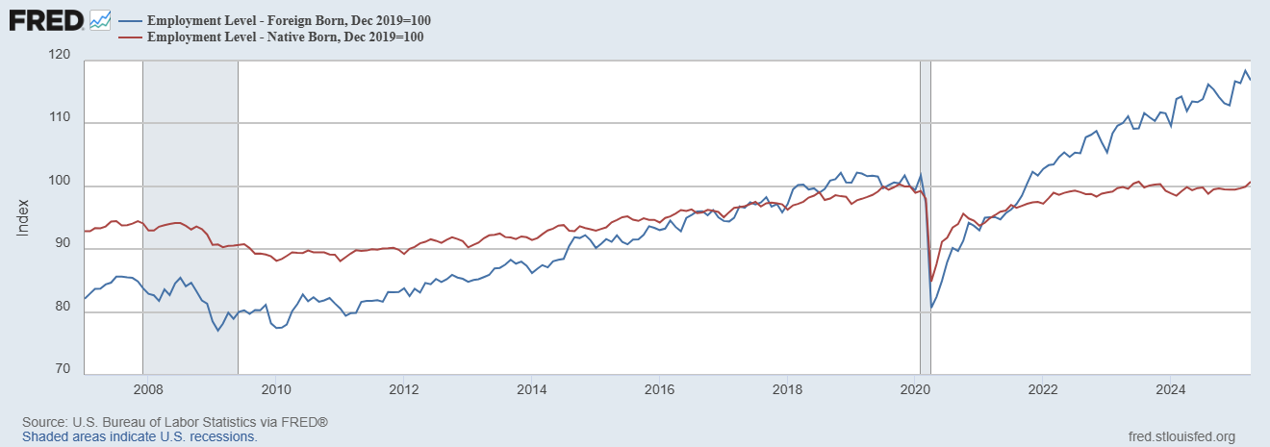
Supplemented by Foreign Workers
Between 12/19 and 4/25
NB employment rose by 1000k
FB employment rose by 3500k

Slide 22
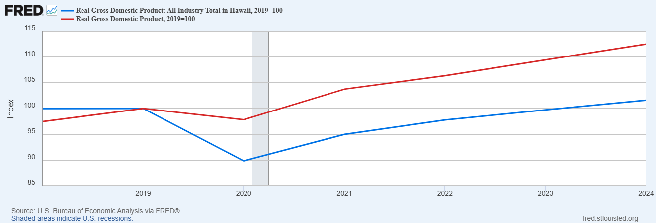
How is Hawaii Doing?

Slide 23
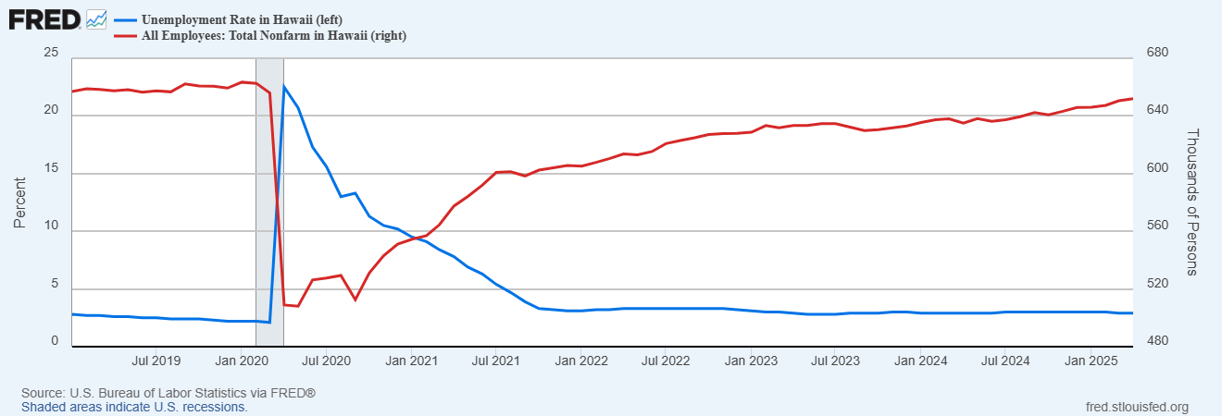
Labor Market in Hawaii
Employment growth since 12/2019, ; -1% vs. 5.1% nationally
Notes:
REI about 1% increase in employment vs. 4.3

Slide 24
Overall Good News on the Real Side
GDP is very close to its potential.
The labor market as measured by the unemployment rate is fully recovered.
But there is also a nominal side: interest rates, asset prices, inflation and wages.
News is pretty good, but progress on inflation seems to have stalled.

Slide 25
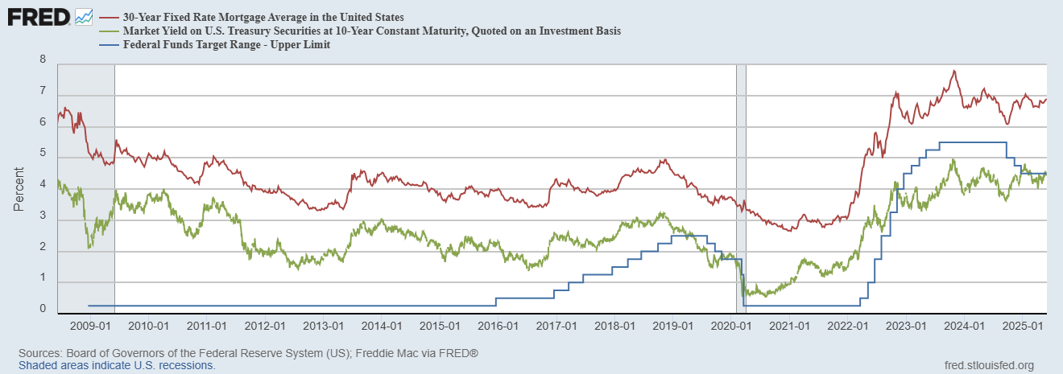
Interest Rates: Era of Falling Rates Over?
Notes:
Fed policy rate 4.5 to 4.25. Concerns with inflation

Slide 26
National Housing Market and Closer to Home
https://www.zillow.com/research/data/

Slide 27
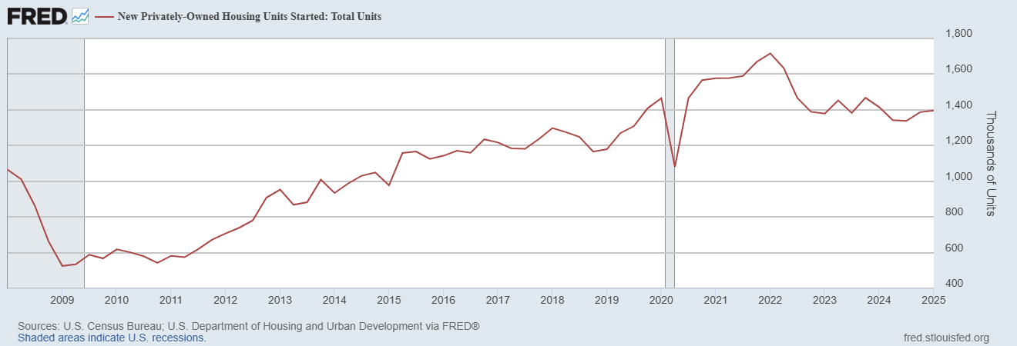
Housing Construction is Slowing?

Slide 28
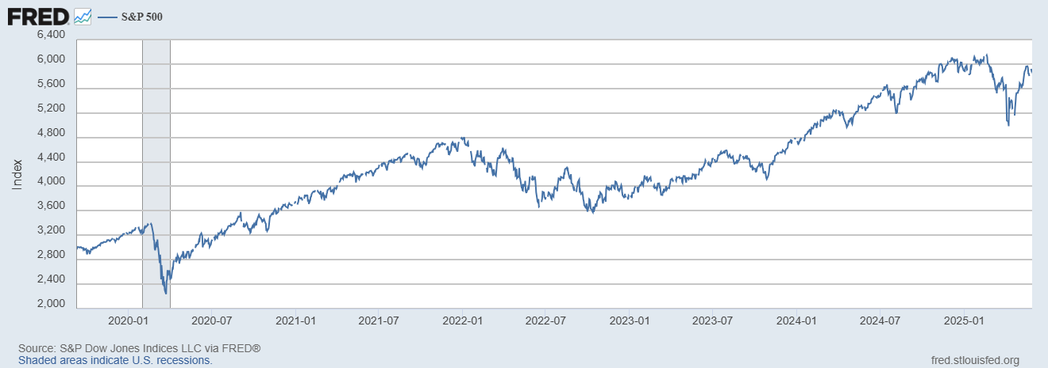
Stock Prices: Its OK to Look at Your 401K Again!
Notes:
Since the end of 2021, lost almost 15%

Slide 29
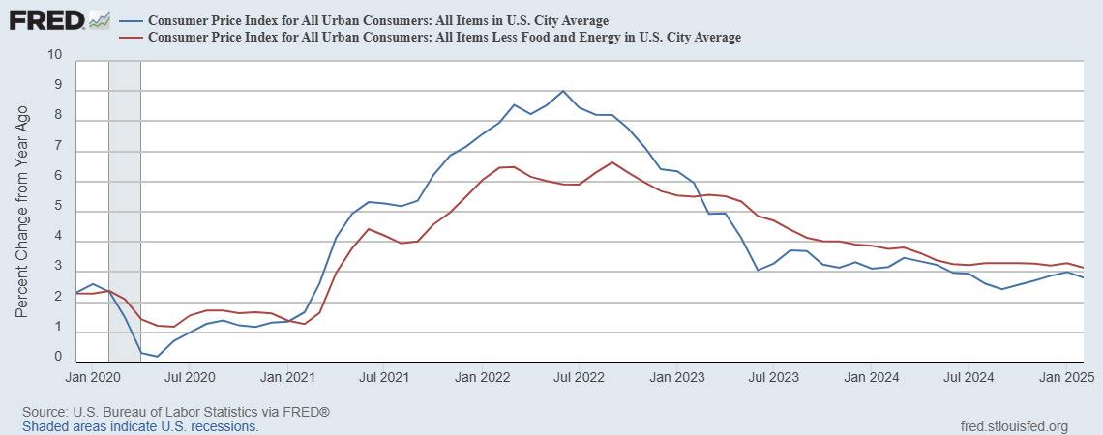
Inflation during the Recovery (CPI)
Notes:
August CPI yoy 8.3% down from 8.5 and Core 6.3 up from 6.3 in JUly

Slide 30
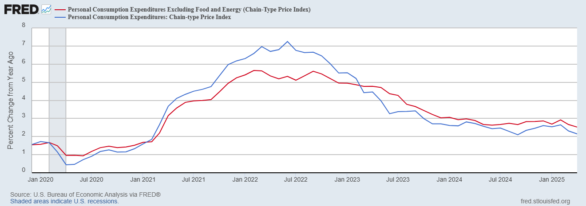
Fed’s Measure (PCE)
March PCE numbers will be released tomorrow
Inflation Accelerates 3/2021
Fed Doesn’t React until 3/2022
Progress slows Spring 2024

Slide 31
CPI vs. PCE: Differences
CPI tends typically to be 0.3 pct point higher
April:
CPI, 2.3%
PCE, 2.1%
Core CPI, 2.8%
Core PCE, 2.5%.
https://www.morningstar.com/markets/whats-difference-between-cpi-pce

Slide 32
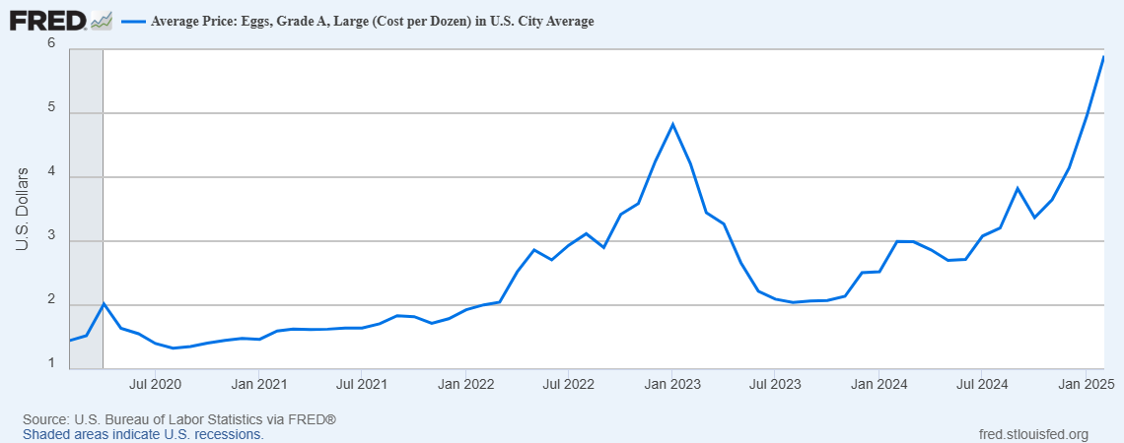
Uses of Inflation Measures
Two Reasons for Measuring Recent Inflation:
What has happened to the Cost of Living?
What is likely to happen to inflation over the next 12-18 months?

Slide 33
Wages Have Finally Caught Up to Inflation
Federal Reserve of Atlanta, “Wage Tracker” and BLS
Notes:
But, note that low wage workers are doing relatively the best

Slide 34
International Comparisons
IMF, World Economic Outlook, 4/2025

Slide 35
The State of the Economy & Effects of Policy
In terms of output and employment the economy is fully recovered
Inflation is still a bit elevated, but close to Fed target.
Policy Effects
Biden Fiscal Stimulus led to a rapid recovery, but may have been too big.
Fed reacted too little and too late and let inflation get out of control.
But since Spring 2023, Fed has been close to perfect.
But Dark Clouds Are Looming on the Horizon,

Slide 36
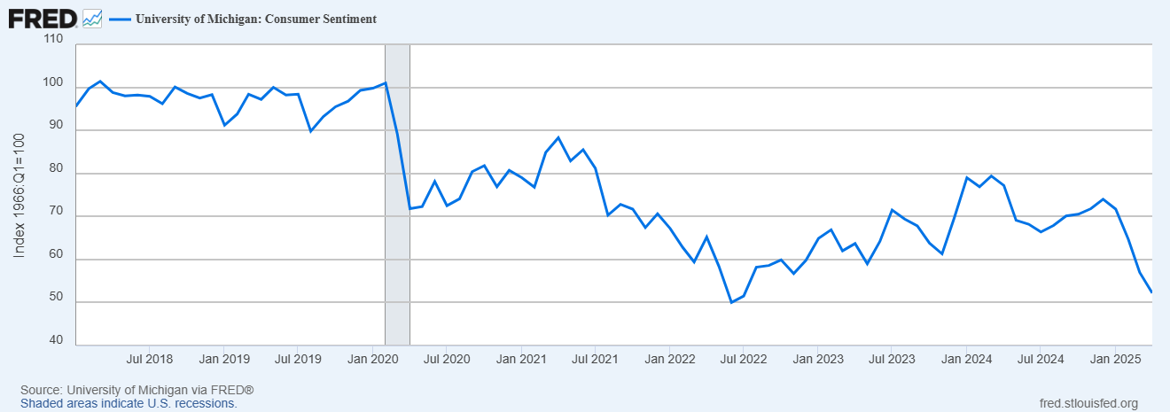
Consumer’s Are Not Happy (2/3rds of GDP)

Slide 37
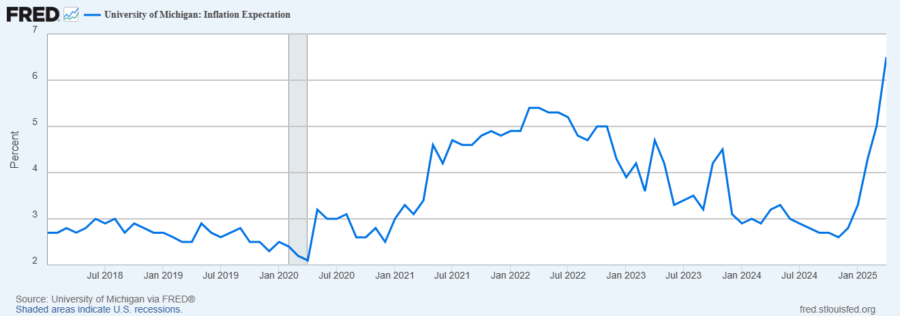
They Are Worried about Inflation

Slide 38
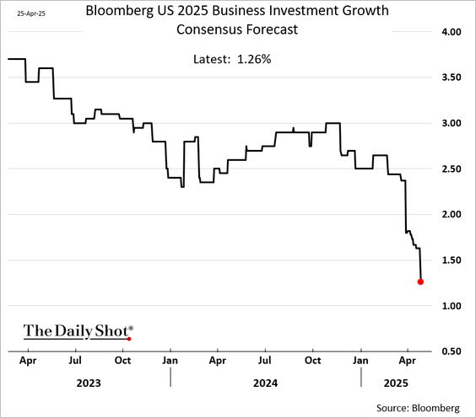
Busineses aren’t Too Happy Either

Slide 39
Professional Forecasters Are Worried

Slide 40
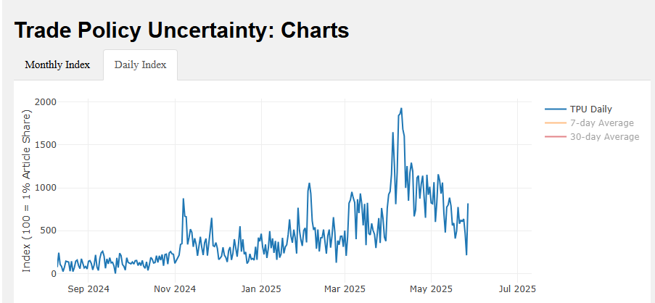
Why the Doom & Gloom
Inauguration
“Liberation Day”
“Data downloaded from https://www.matteoiacoviello.com/tpu.htm on May, 14,2025).

Slide 41
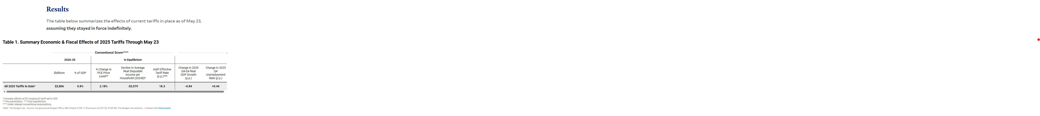
StagFlation and the Fed’s Dilemma
Tariffs in place if the Court Ruling is upheld: 0.6% price level 0.1 pct points unemployment
The Dilemma: To fight inflation the Fed needs to raise interest rates
To fight unemployment the Fed needs to lower interest rates
https://budgetlab.yale.edu/research/state-us-tariffs-may-23-2025

Slide 42
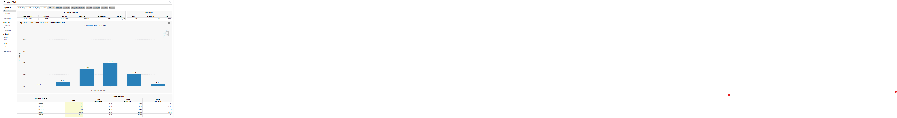
What Will the Fed Do?
https://www.cmegroup.com/markets/interest-rates/cme-fedwatch-tool.html

Slide 43
What Will Congress Do?
For detailed provisions https://bipartisanpolicy.org/explainer/2025-reconciliation-whats-in-the-ways-and-means-bill/
https://www.crfb.org/blogs/adding-house-reconciliation-bill

Slide 44
Citizen’s Guide to “Budget Reconciliation.”
Procedure successfully used 22 times since 1974 to avoid a Senate filibuster.
Reconciliation can be used for changing taxes and spending (not Social Security) subject to the Byrd Rule.
Byrd rule:
  No extraneous provisions.
  No increase in the deficit after 10 year window.
Reconciliation games played by both parties:
  BBB.
  2017 Trump Tax Cut

Slide 45
CBO: Budget Analysts in Chief
The Congressional Budget Office was founded in 1974 to provide Congress with information about the budgetary implications of legislation.
Two kinds of Reports
  Cost Estimates or “Scoring”
    H.R. 5409, Safeguarding American Farms from Foreign Influence Act
    Build Back Better Scoring.
Projections of Debt and Deficits – The Budget and Economic Outlook: 2025 to 2035,
  https://www.cbo.gov/publication/60870
Notes:
Lindsey Graham an alternate scoring

Slide 46
Reconciliation and CBO Projections
For the CBO to be effective it must be perceived to be (and must be) nonpartisan.
Therefore, CBO “baseline” projections and legislative scoring must not try to predict changes in legislation.
Instead, CBO must analyze the data based on the current law as written (e.g., 2017 Personal Tax cuts expire this year).
CBO is allowed to provide analyses of policy options.
(“Options for Reducing the Deficit: 2025 to 2034,” https://www.cbo.gov/publication/60557”
Notes:
One exception: assumes SS will be paid

Slide 47
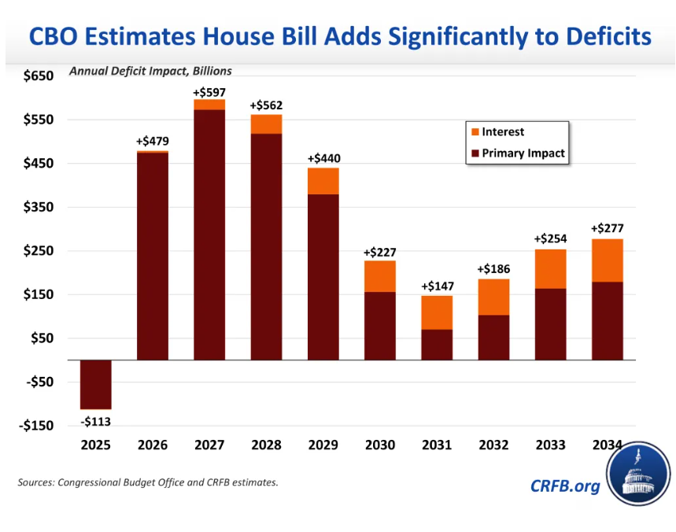
The Reconciliation Game in Action

Slide 48
More Realistic Estimates?

Slide 49
Distributional Effects
2022 data on average before tax family income by quintiles
0-20, $16.1K
20-40: $43.9
40-60: $74.7
60-80: $119.9K
80:100:$277.3K

Slide 50
A Brief Primer on Tariffs
Tariffs are a sales tax on imported goods, collected from importers
The burden of the tariff in general falls on buyers of imports (consumers and firms) to the extent of higher prices and on the foreign country.
Economist don’t like tariffs in general because they reduce the gains from trade
  More efficient utilization of global resources: Why doesn’t Patrick Mahomes mow his own lawn
  Economies of scale for producing for large markets.
Gains to Trade Taken to a New Level with Global supply chains

Slide 51
Possible Economic Arguments for Tariffs
Possible arguments for tariffs
  National Defense – strategic resource. Do we need the capacity to make our own computer chips, just in case?
  “Infant” Industry
  Temporary strategy to reduce foreign tariffs

Slide 52
History of US Average Effective Tariff Rates
Inc. Tax
Smoot-Hawley
https://budgetlab.yale.edu/research/state-us-tariffs-april-15-2025

Slide 53
Doesn’t Congress Set Taxes, including Tariffs?
Yes, but Congress has delegated the authority to raise tariffs 4 times
  1930; If a foreign country discriminates against US commerce, tariff rate upt to 50%
  1962: If imports threaten national security following an investigation by the Secretary of Commerce
  1974: If the US International Trade Commission finds that a surge in imports is harming domestic industries up to 50%.
  1977: President declares a national emergency due to “an unusual and extraordinary threat” originating outside the US.
President Trump has been claiming tariff authority from 2&4., but is being challenged in courts.

Slide 54
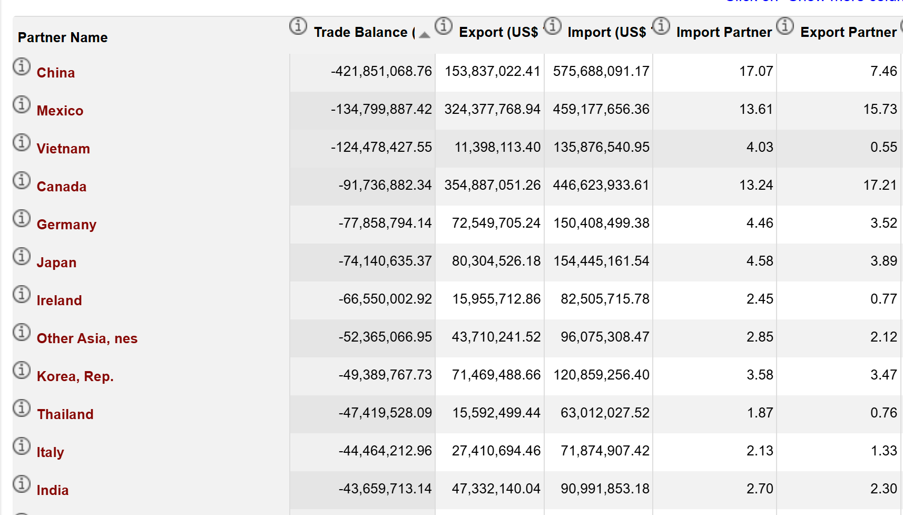
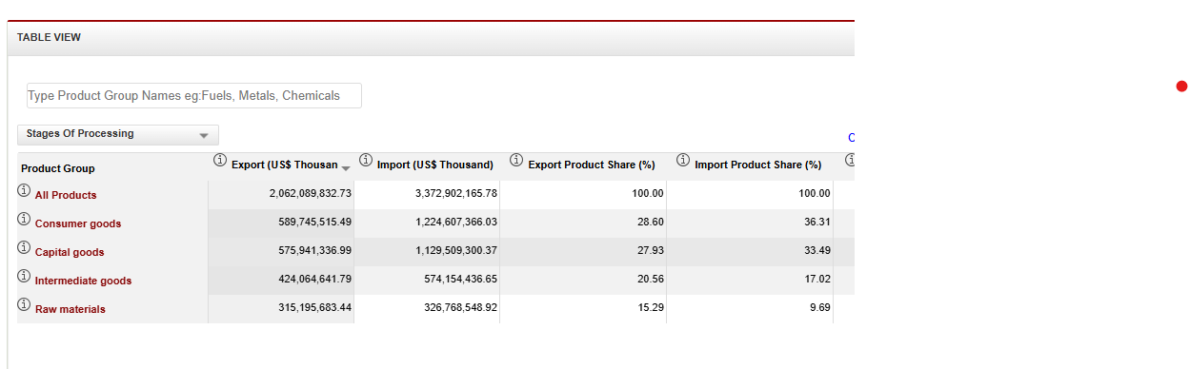
US Trade Balance & Type of Imports
https://wits.worldbank.org/CountryProfile/en/Country/USA/Year/2022/TradeFlow/EXPIMP/Partner/by-region

Slide 55
Tariffs and Trade Deficits
Remember, Trade Deficits are the mirror image of investment greater than national saving.
For the trade deficit to fall either national saving must rise and/or investment must fall (not what we want).
For national saving to rise
  Households and businesses must save more, or
  The government deficit must fall.

Slide 56
So, What Do Tariffs Do?
Tariffs do increase national saving by raising revenue, but also
Decrease the demand for the goods subject to the tariff, which
Increases the value of the dollar, thereby
  Lowering our exports as domestic goods cost more to foreigners.
  Offsets some but not all of the effect of the tariff on total imports, as non-tariffed imports are cheaper.
Net Effect (first approximation)
  Exports fall, Total Imports fall, and the change in the trade balance is solely due to reduced government deficit.
  Composition of imports changes while the relative share of non-tariffed imports rises.

Slide 57
Distributional Effects
Poor hurt relatively the most, “regressive” tax

Slide 58
Putting Tariff, Tax & Spending Policies Together
Don’t Forget the largest Effects on the Deficit occur in the first 2 or 3 years!

Slide 59
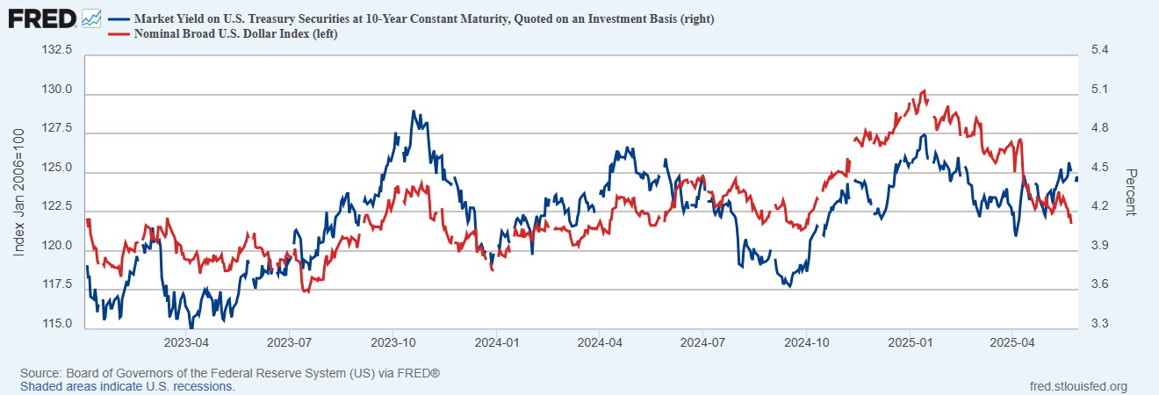
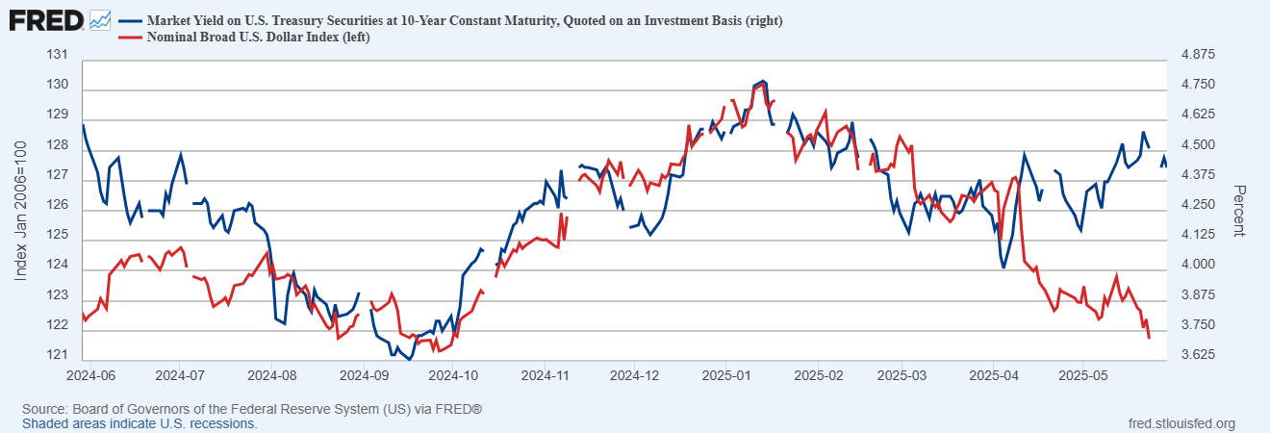
An Ominous Combination

Slide 60
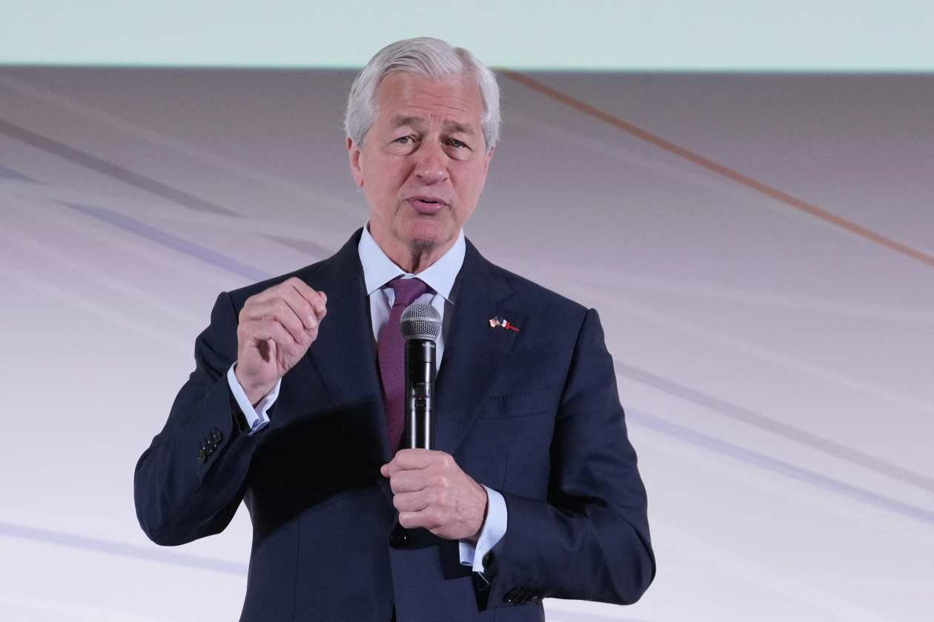
Jamie Dimon (JPMorganChase) is Worried
You are going to see a crack in the bond market, OK?... I just don’t know if it’s going to be a crisis in six months or six years.
What I really worry about is us,” he said. “Can we get our own act together—our own values, our own capabilities, our own management?
WSJ, May, 30,2025
Notes:
Financial crises take much longer to develop than you expect, and then when they happen, they happen much more quickly than you expect

Slide 61
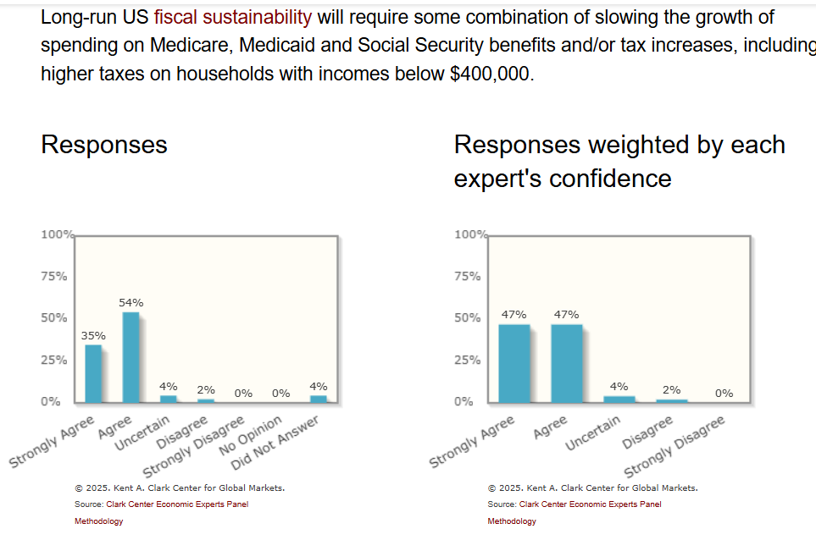
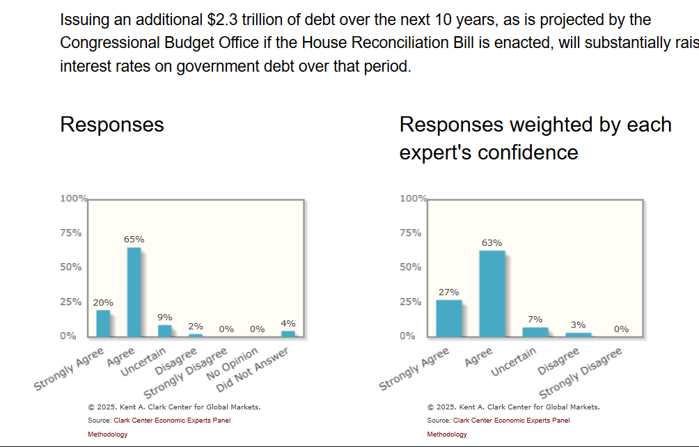
Economist Views on the Solution

Slide 62
My Google Site
https://sites.google.com/view/macro-current-issues/economic-update

Slide 63
Let’s Hear from You!
Geoffrey Woglom grwoglom@amherst.edu
Contact NEED: Info@NEEDEcon.org
Support NEED: www.NEEDEcon.org/donate.php

